Slide 1
ERASMUS+ ROMANIA
Creating rescue teams - getting ready for natural disasters

Slide 2
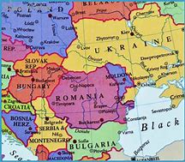
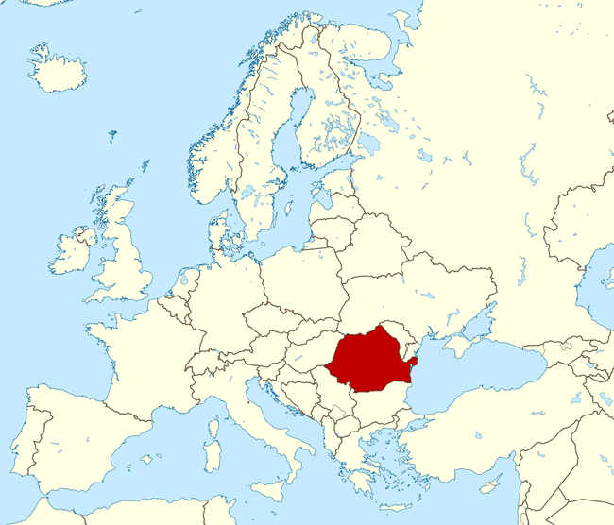
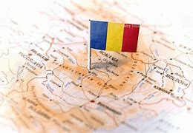
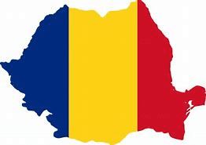
Romania is a state located in south-eastern Central Europe, on the lower reaches of the Danube, north of the Balkan peninsula and on the north-western shore of the Black Sea. On its territory is located almost the entire surface of the Danube Delta and the southern and central part of the Carpathian Mountains.

Slide 3
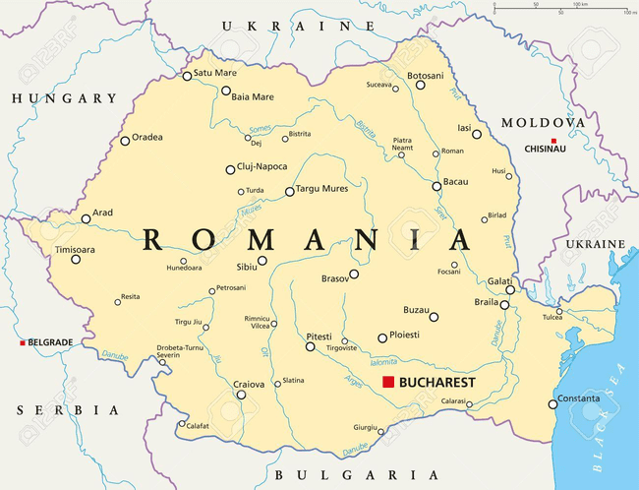
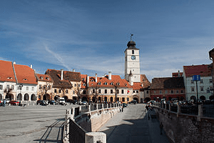
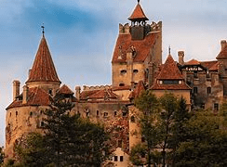
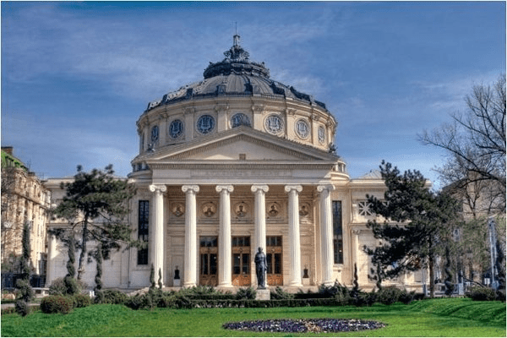
Capital : Bucharest
Surface : 238 397 km²
Population : 19 million people

Slide 4
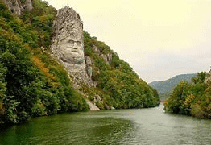
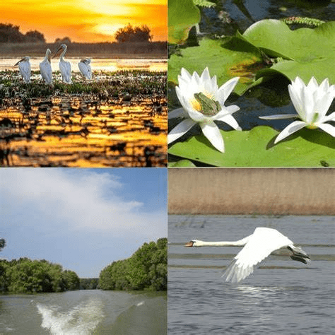
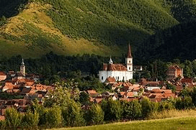
Crossed by the waters of the Danube, Romania has a varied relief, including the forested Carpathian Mountains, the Black Sea coast and the Danube Delta, the best preserved European delta. Romanian villages generally keep a traditional way of life. Romania enjoys an abundance of religious architecture and preserves several medieval towns and castles.

Slide 5
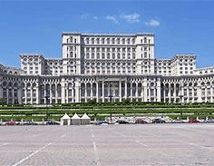
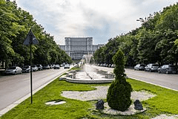
THE PARLIAMENT PALACE
The Palace of the Parliament , also known as People's House/People's Palace , is the seat of the Parliament of Romania, located atop Dealul Spirii in Bucharest, the national capital.The Palace of the Parliament is the heaviest building in the world, weighing about 4.10 million tonnes, also being the second largest administrative building in the world.

Slide 6
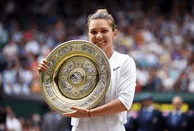
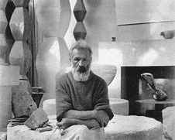
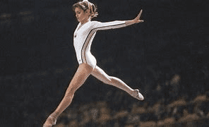
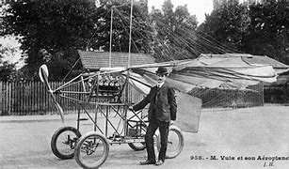
Romanian Personalities
Simona Halep is a Romanian professional tennis player. She has been ranked world No. 1 in singles twice between 2017 and 2019, for a total of 64 weeks, which ranks eleventh in the history of the Women's Tennis Association.
Nadia Elena Comaneci is a Romanian retired gymnast and a five-time Olympic gold medalist, all in individual events.In 1976 at the age of 14, Comaneci was the first gymnast to be awarded a perfect score of 10.0 at the Olympic Games.
Constantin Brâncuși was a Romanian sculptor, painter and photographer who made his career in France.Considered one of the most influential sculptors of the 20th-century and a pioneer of modernism, Brâncuși is called the patriarch of modern sculpture.
Traian Vuia was a Romanian inventor and aviation pioneer who designed, built and tested the first tractor monoplane. He was the first to demonstrate that a flying machine could rise into the air by running on wheels on an ordinary road.

Slide 7
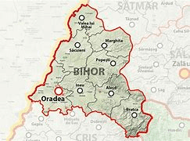
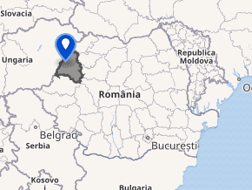
BIHOR COUNTY
Bihor is a county of Romania, in the historical region of Crișana located in the north west of Romania.

Slide 8
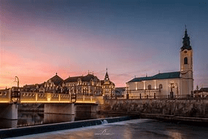
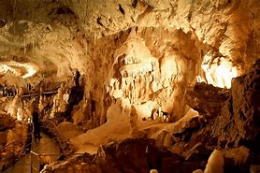
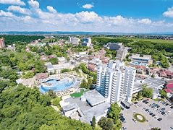
The main tourist attractions in the county are:
The city of Oradea
Băile Felix Resort
The Apuseni Mountains :
The city of Oradea
The Bear's Cave
The Caves around Padiș and on the Sighiștel River Valley
The Bear's Cave
Băile Felix Resort

Slide 9
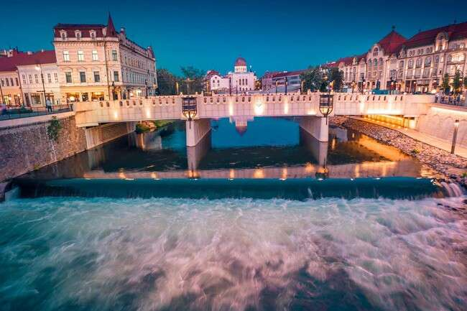
ORADEA

Slide 10
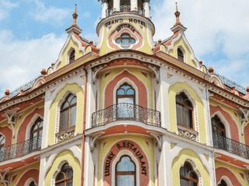
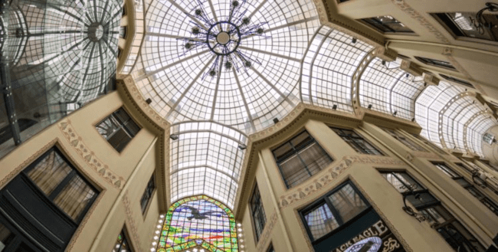
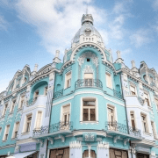
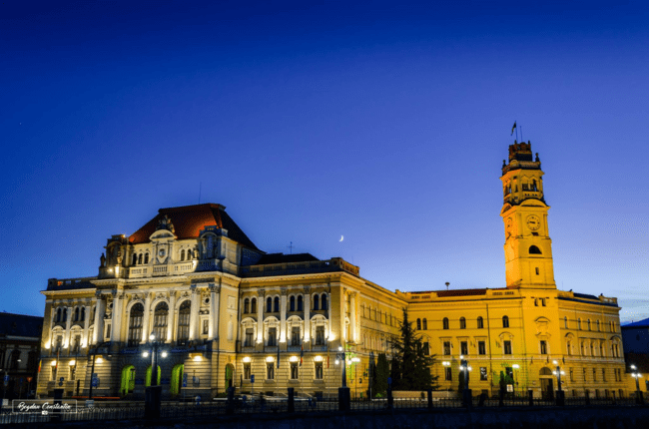
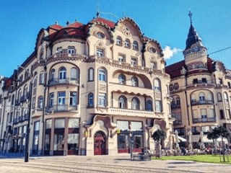
Oradea is one of the most important economic, social and cultural centers in the western part of Romania. Oradea hosts a rich Art Nouveau architectural heritage, being the only city in Romania included in Art Nouveau European Route.

Slide 11
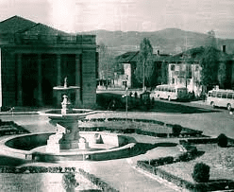
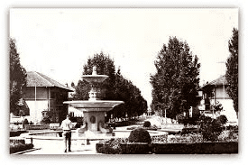
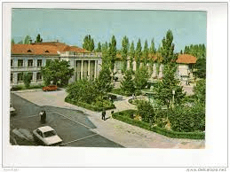
ȘTEI
The town of Ștei was arranged by the soviet regime in 1952-1956 and was named Dr. Petru Groza during the communist era, after the Romania socialist leader Petru Groza. It was founded as an industrial centre for the grinding of uranium mine in a nearby town.
At present, 6.529 people live in this town.
Stei in 1956

Slide 12
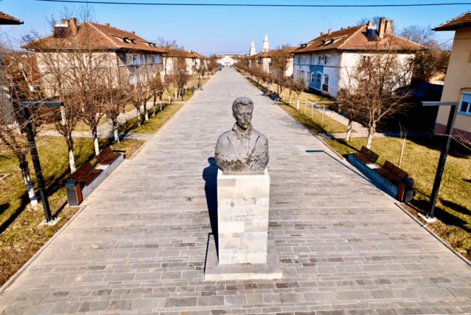
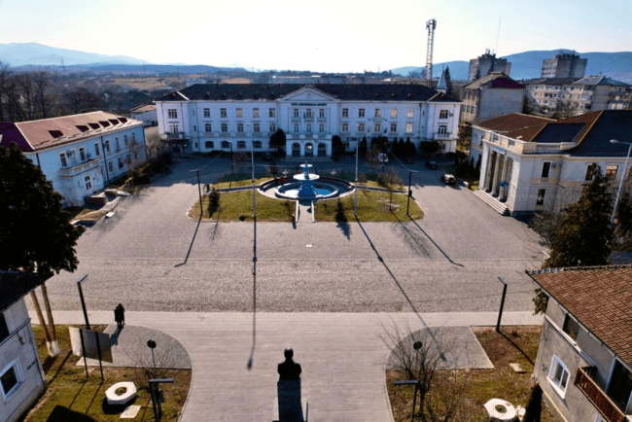
ȘTEI NOW

Slide 13
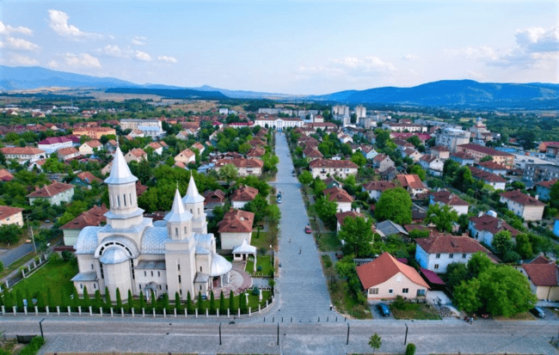
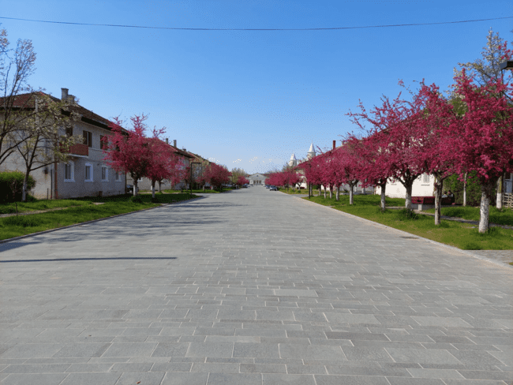

Slide 14
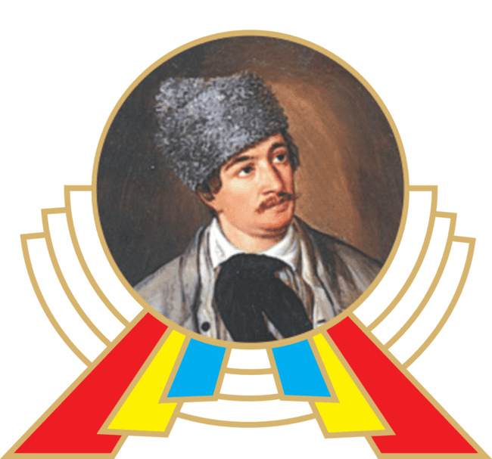
The National College "Avram Iancu"-Stei
NATIONAL COLLEGE "AVRAM IANCU" STEI

Slide 15
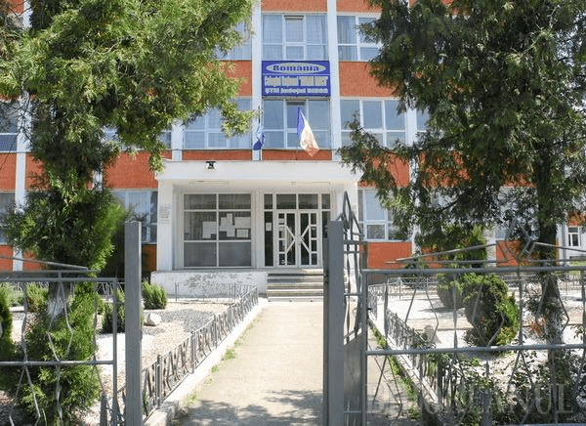
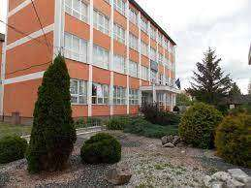
Educational system:
Gymnasium includes grades 5-8. The access to the higher level is achieved by a national evaluation examination and distribution in upper secondary education units.
The secondary superior education includes the high school grades 9-12 ( theoretical pathway).
Realistic profile:
-mathematics-computer studies
-nature studies
Humanist studies:
-philology

Slide 16
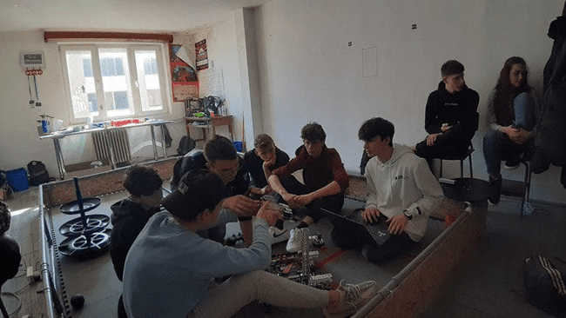
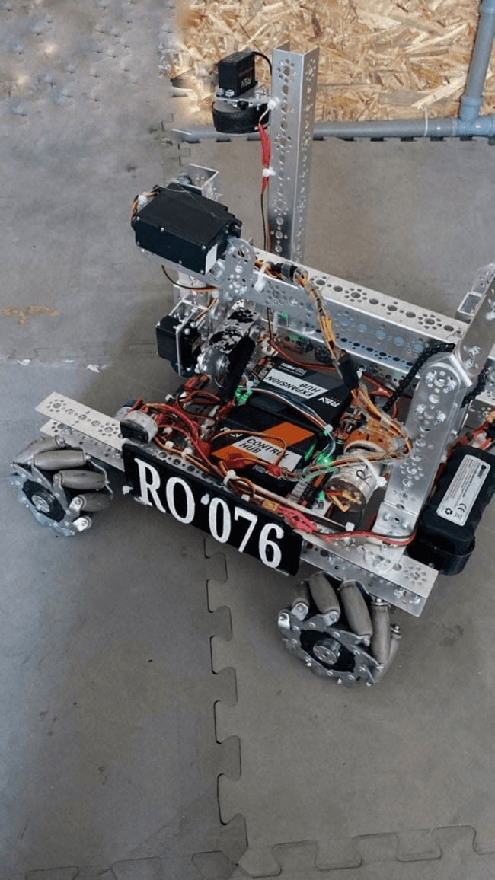
Robotics club of our school

Slide 17
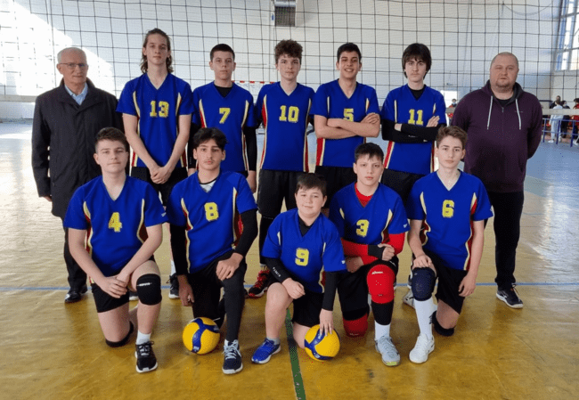
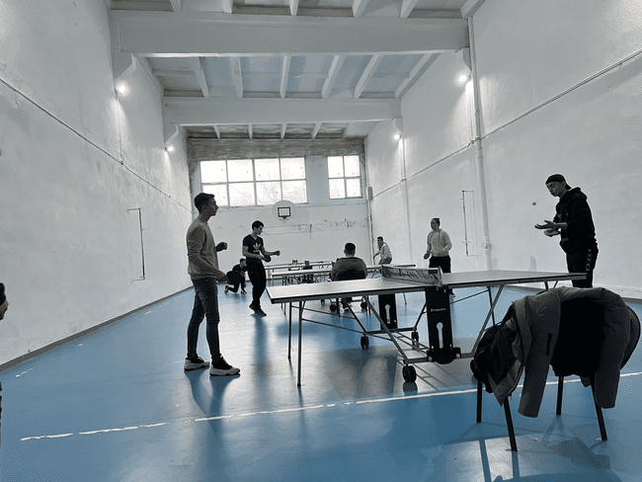
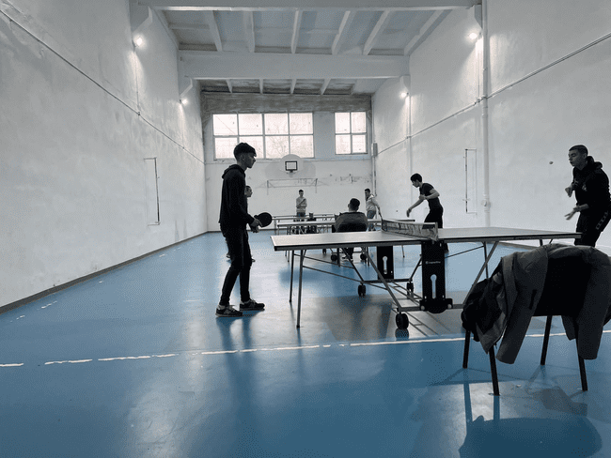
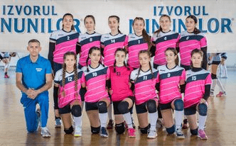
Volleyball Club and Table tennis competition
Volleyball Club
Table Tennis competition

Slide 18
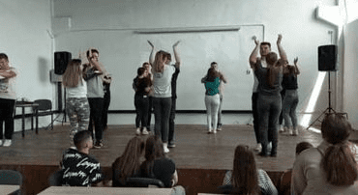
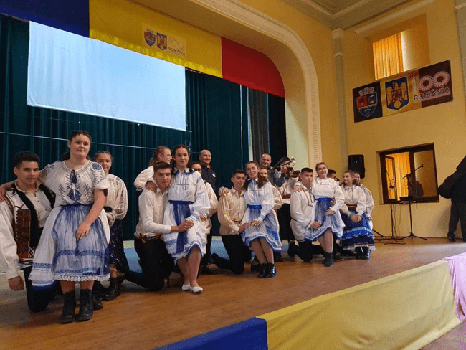
Traditional dance club

Slide 19
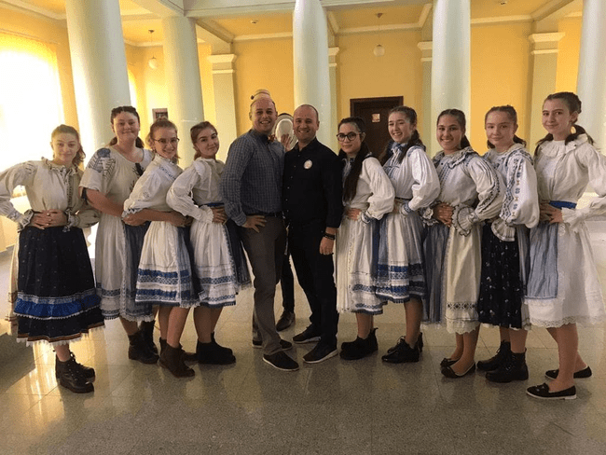

Slide 20
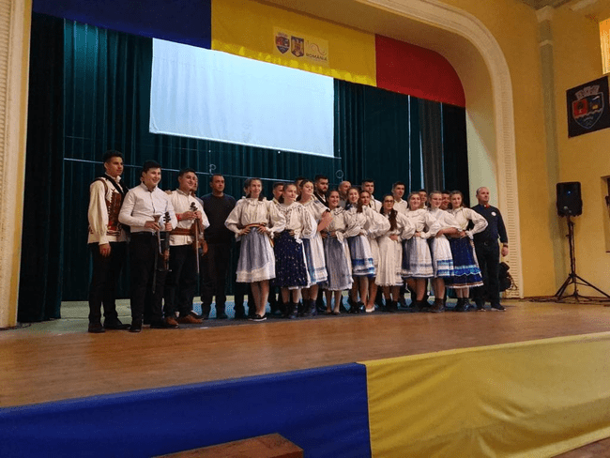

Slide 21
